Slide 1



Smart Healthcare Analytics and Patient Insights
Gurnule Snehal
Raghavendra Rao M S
College Name -
Samskruti College of Engineering and Technology

Slide 2

Project Objectives
Problem Statement
Project Overview – Introduction
End Users
Wow Factor in Project
Modelling/Block Diagram/Flow of Project
Result/outcomes
Conclusion
Future Perspective

Slide 3
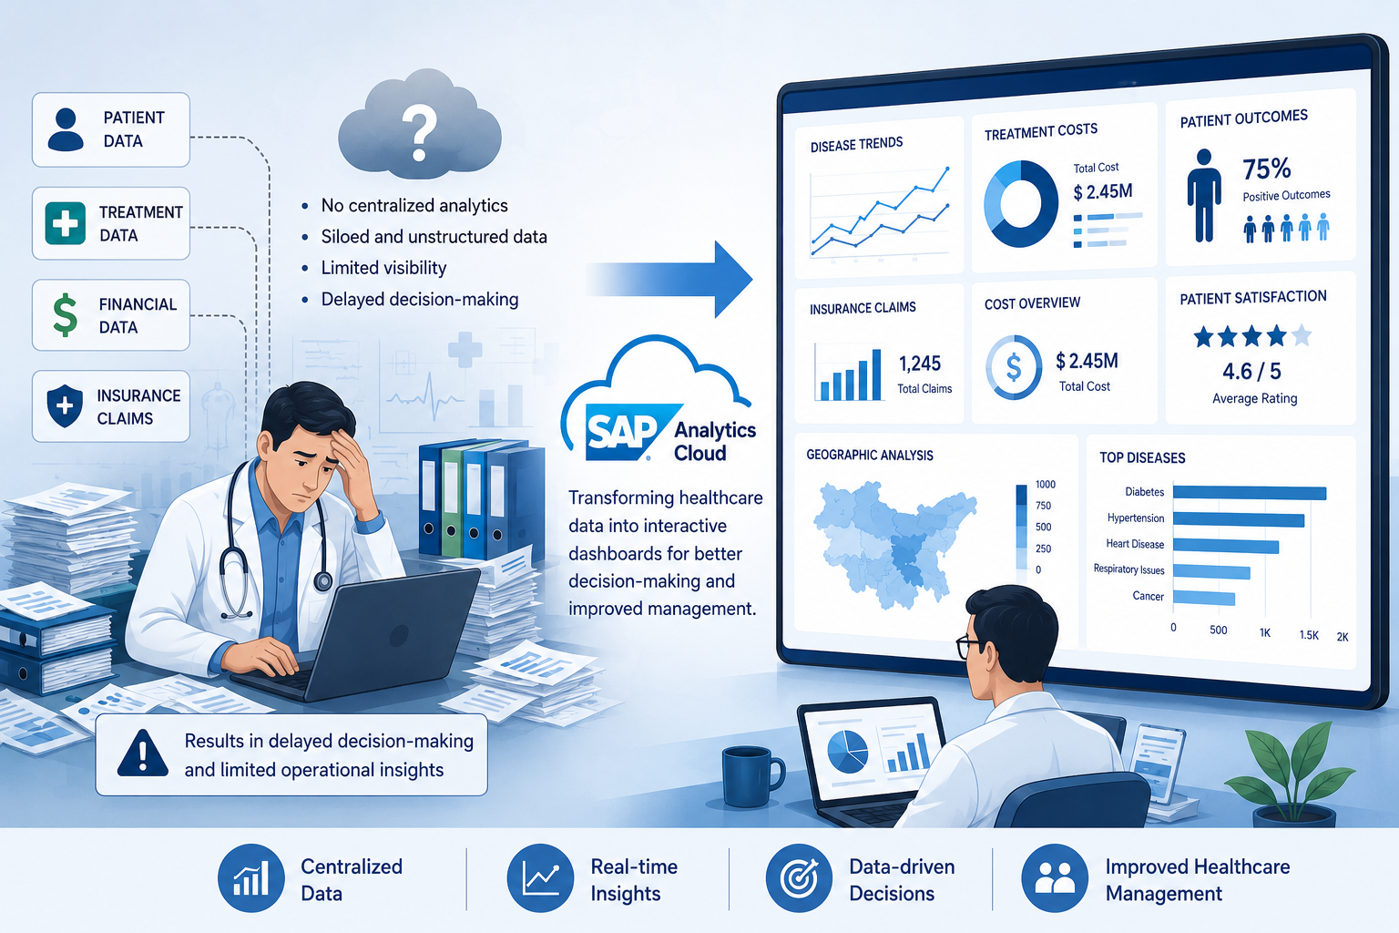
Problem Statement
Healthcare institutions often struggle to convert large volumes of patient and treatment data into actionable insights. This project uses SAP Analytics Cloud to provide interactive analytics for monitoring patient trends, treatment costs, insurance claims, and healthcare outcomes, enabling faster and smarter decision-making.

Slide 4
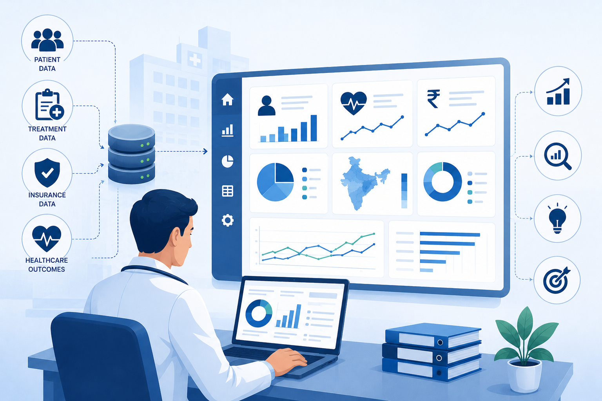
Project overview - Introduction
Smart Healthcare Analytics and Patient Insights is an SAP Analytics Cloud-based solution that converts healthcare data into actionable insights through interactive dashboards. It helps analyze patient trends, disease patterns, treatment costs, insurance claims, and healthcare outcomes to support data-driven decision-making.

Slide 5
End User
Hospital Management
Monitor hospital performance
Resource planning
Healthcare Administrators
Track patient trends
Analyze treatment effectiveness
Financial Department
Monitor treatment costs
Analyze insurance claims
Policy Makers
Identify regional healthcare trends
Support healthcare planning
Medical Researchers
Study disease patterns
Evaluate treatment outcomes

Slide 6
Wow Factor in Solution
Interactive Multi-Page SAC Dashboards
Dynamic Filtering and Drill-Down Analysis
Disease-Wise Patient Insights
Insurance Claim Analytics
Treatment Cost Optimization Insights
Patient Outcome Monitoring
Smart Insights and Forecasting
Innovation
Instead of static reports, the solution provides real-time, interactive healthcare intelligence enabling data-driven decision-making.

Slide 7
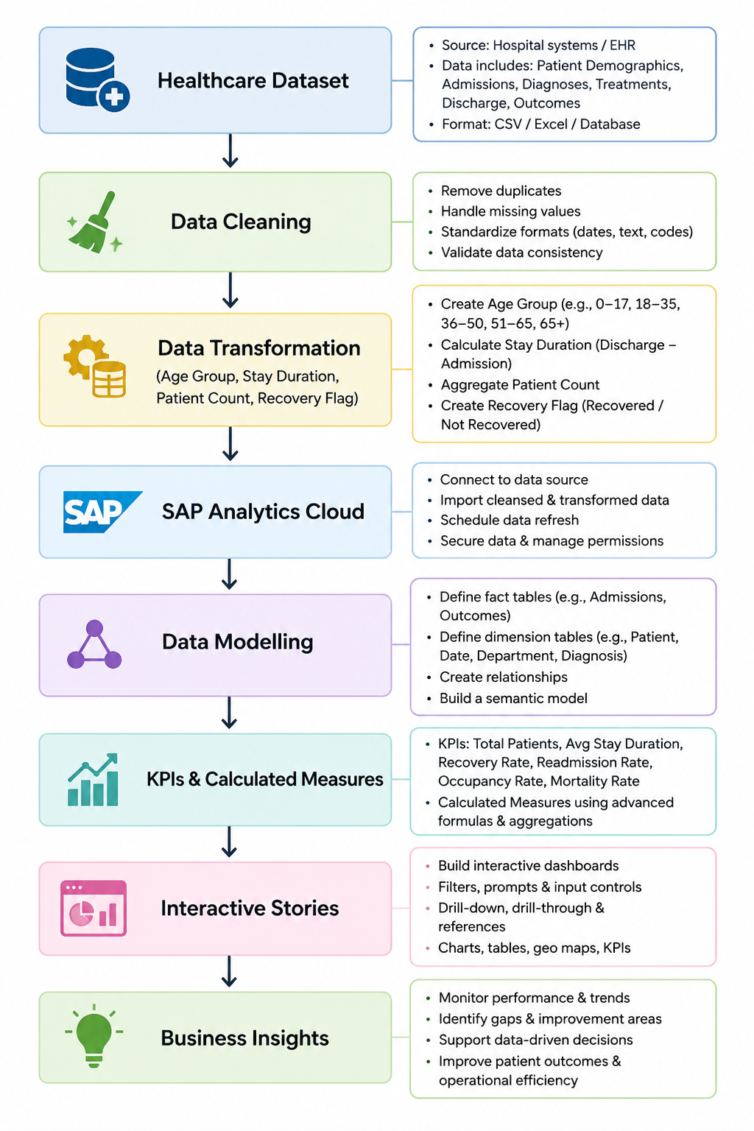
Flow of Project
The healthcare dataset is first cleaned and transformed to improve data quality and create meaningful analytical fields such as Age Group, Stay Duration, Patient Count, and Recovery Flag. The processed data is then imported into SAP Analytics Cloud, where data modelling, KPI creation, and interactive stories are developed to generate actionable healthcare insights and support data-driven decision-making.
​

Slide 8
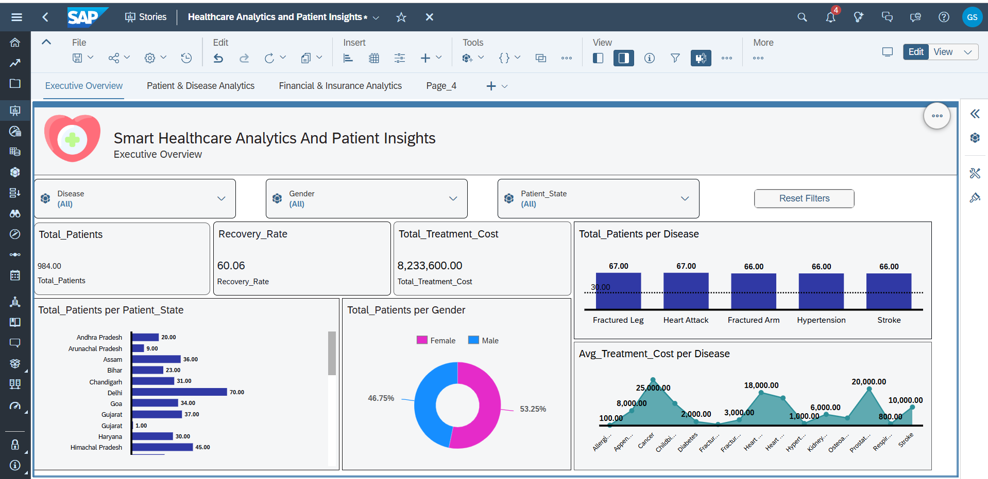
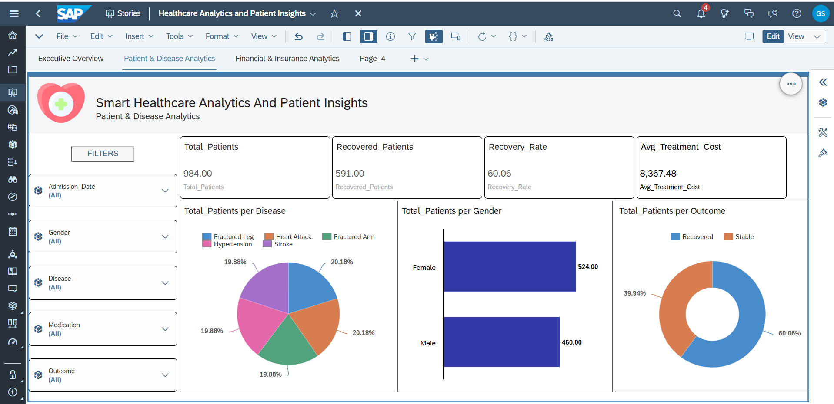
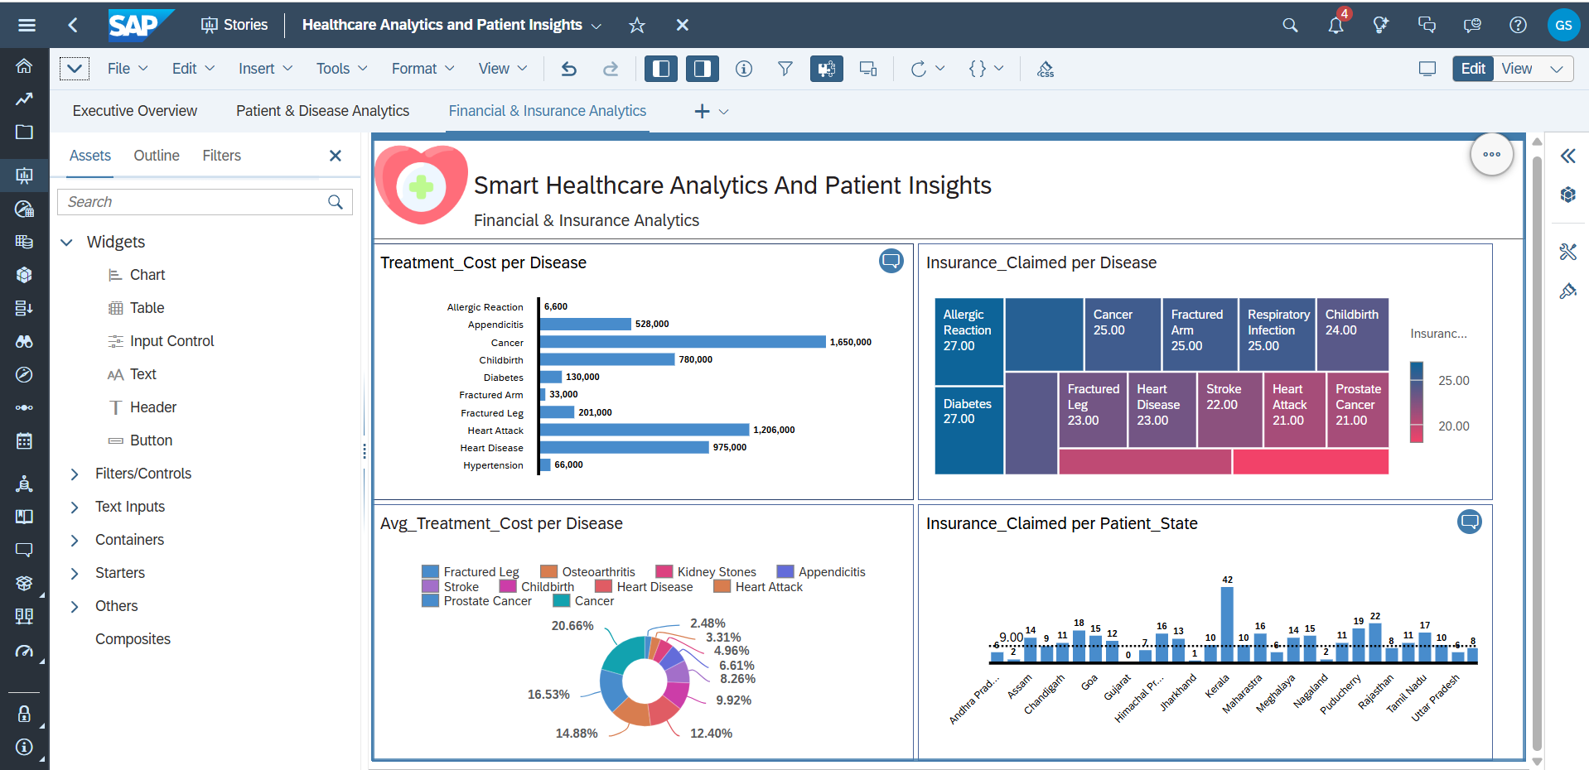
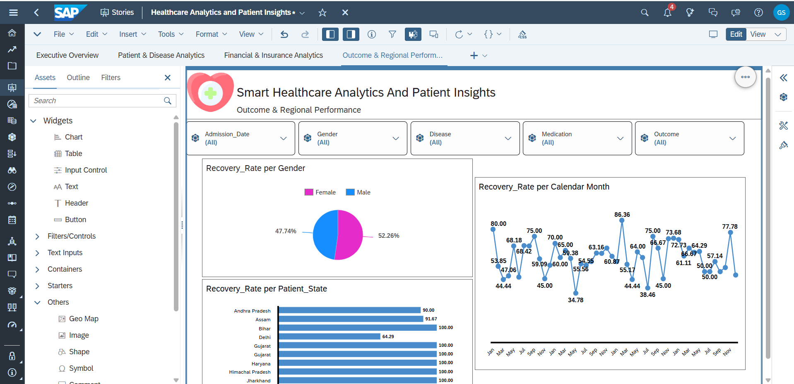
Result / Outcomes
​

Slide 9
Conclusion
The Smart Healthcare Analytics and Patient Insights project successfully demonstrates how SAP Analytics Cloud can transform healthcare data into meaningful and actionable insights. By analyzing patient demographics, disease patterns, treatment costs, insurance claims, and healthcare outcomes through interactive dashboards, the solution enables efficient monitoring and informed decision-making. The project highlights the power of data-driven healthcare analytics in improving operational efficiency, resource planning, and overall healthcare management.
Through interactive dashboards, healthcare organizations can:
Monitor patient trends
Analyze disease patterns
Evaluate treatment costs
Improve insurance management
Support data-driven decision-making

Slide 10
Future Perspective
Future Enhancements
Real-time hospital database integration
AI-based disease prediction
Patient risk scoring
Predictive healthcare analytics
Mobile healthcare dashboards
Integration with Electronic Health Record (EHR) systems
Department-wise performance analytics
Advanced forecasting using machine learning

Slide 11
Thank you...!
Notes:
11

